Slide 1

Household Utility Maximization and the Working Wife
AUTHOR : WENDY LEE GRAMM
ILINA JHA

Slide 2
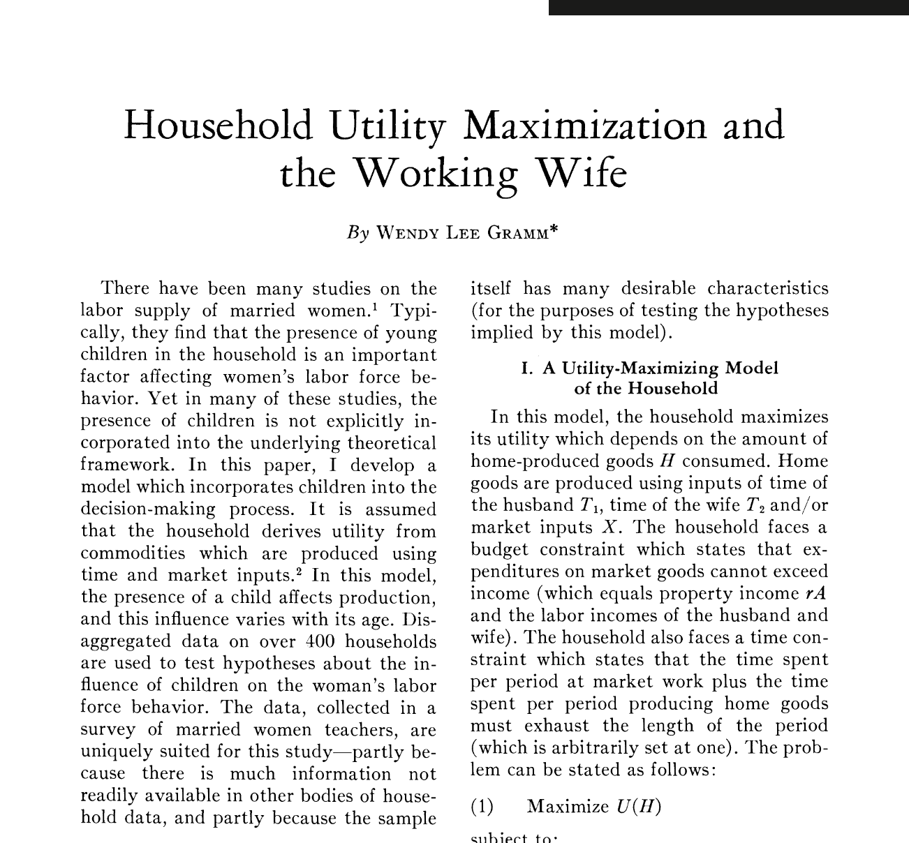
Background
Many studies on Labor Supply of Married Women
Presence of Children

Slide 3
Problem Statement
The study investigates household decisions on labor supply, particularly for married women, are influenced by factors such as children, wages, and household characteristics.
Key Assumptions
Households derive utility from home-produced goods and make decisions within budget and time constraints.
With age the husband and wife acquire skills and experience which causes the marginal products of their time in the production of home goods to increase.
The purpose of this paper is to derive the wife’s labor supply, so it is assumed the husband always spend some time at market labor

Slide 4
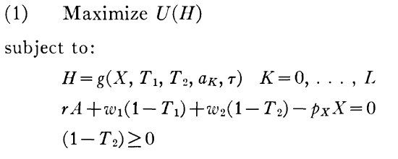

Methodology I
Utility Maximization: Utility depends on home-produced goods derived from time inputs (husband/wife) and market goods.
Notes:
Budget: Income (wages and assets) equals expenditure on goods.
Time: Total time is allocated between market work and home production.
Wife Spending Time: Wife may choose to spend all her time at home

Slide 5
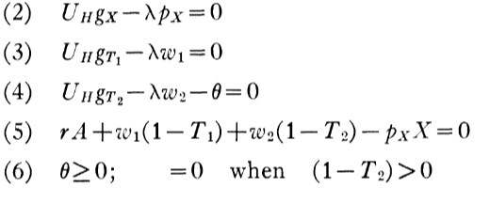
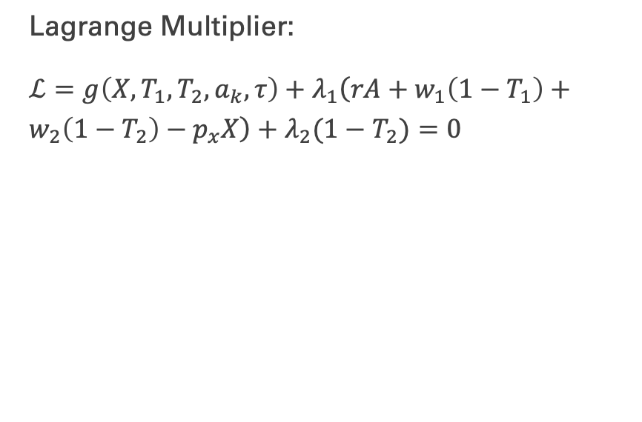
Methodology II
First Order Conditions

Slide 6
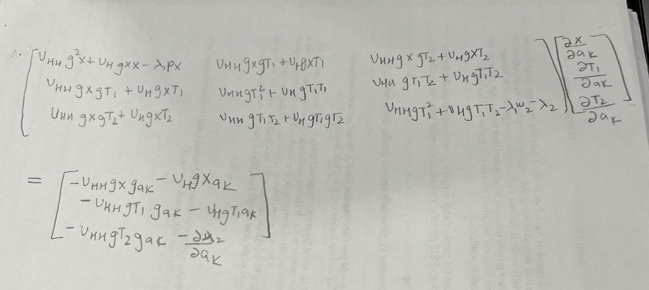

Methodology III

Slide 7
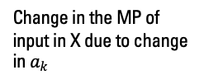
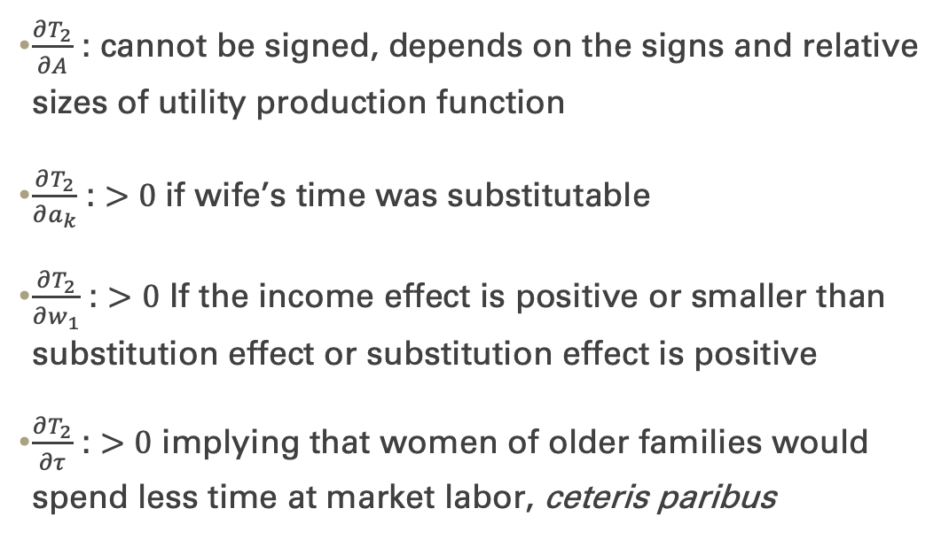
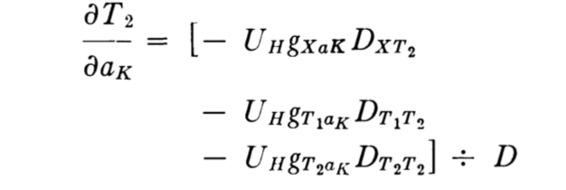
Important Relations
MU of home goods
Substitution effect
Notes:
Dij represents the cofactor of the ith row and jth coloumn of the matrix where rows and col are indexed X, T_1, T_2, 𝜆

Slide 8
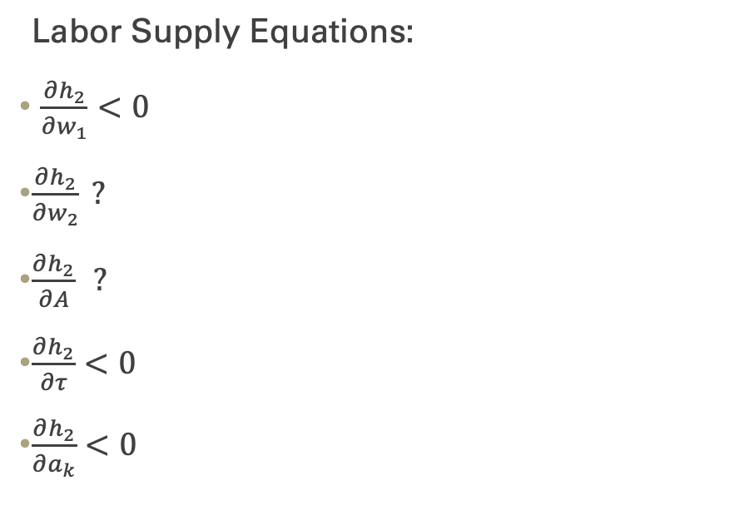
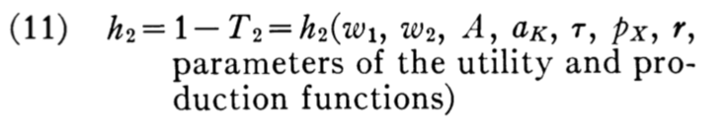
Important Relations
Wife’s labor supply
Notes:
Labor Supply Equations signs of partial derivatives

Slide 9
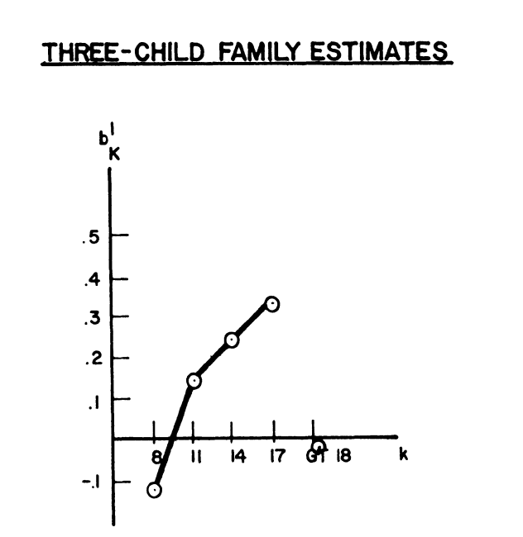
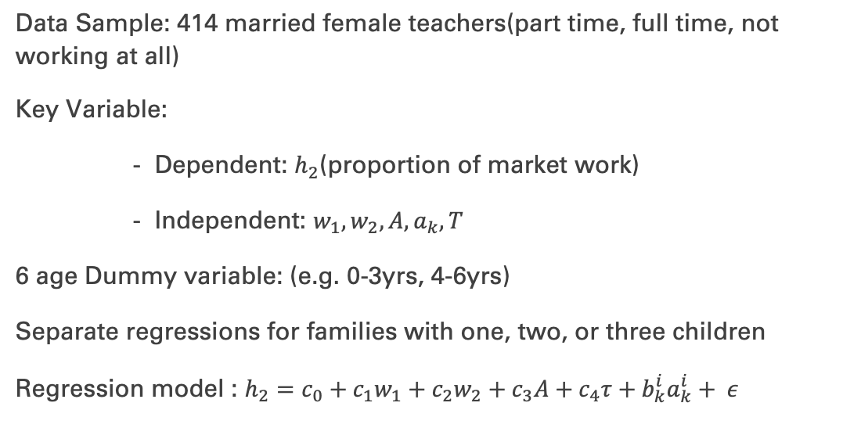
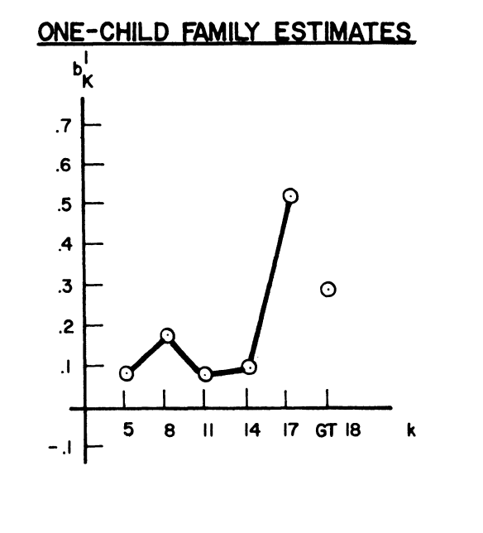
Statistics (Evidence)
Notes:
Omitted group is the family with no children
They represent a controlled group with consistent qualifications and work conditions.

Slide 10
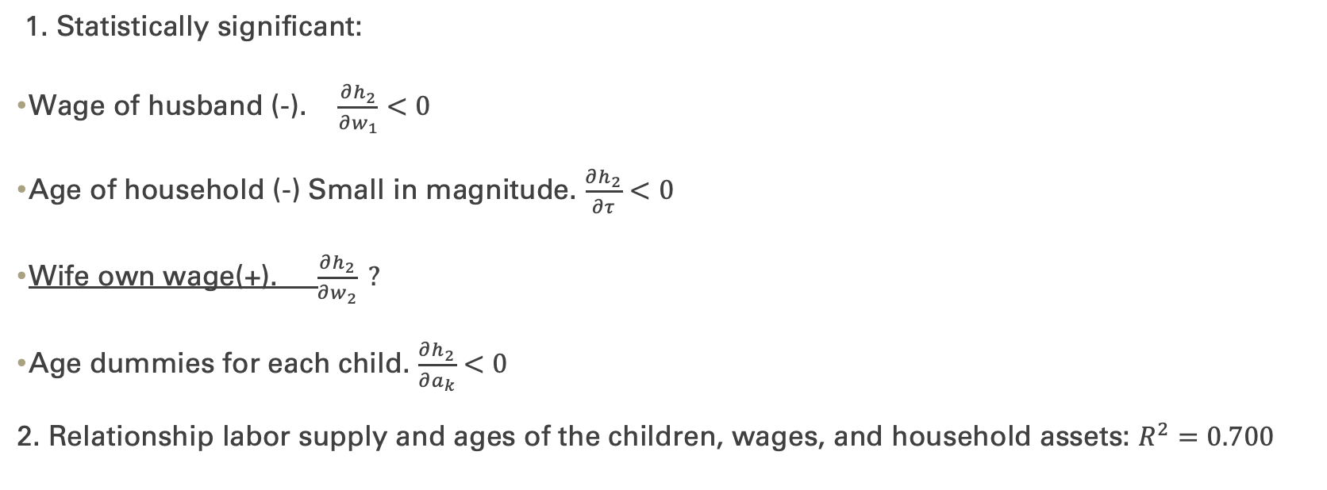
Statistics Evidence
Notes:
Choice that set a woman in sample face rather the response to change in 𝑤_2.

Slide 11
Results
Child age: Women’s Labor supply decreases with younger children but increases as children age
The husband's wage negatively affects the wife’s labor supply
Higher household assets have a limited but negative impact
Women in households with more children return to work faster due to increased financial needs.

Slide 12
Conclusion
Research
Labor supply decisions are a balance between economic needs, household composition, and utility derived from home production.
Women’s labor supply increases as caregiving demands decrease.
Subsidized childcare for young children
Part-time opportunities for mothers.

Slide 13
Source
Gramm, Wendy Lee. “Household Utility Maximization and the Working Wife.” The American Economic Review, vol. 65, no. 1, 1975, pp. 90–100. JSTOR, http://www.jstor.org/stable/1806398. Accessed 11 Dec. 2024.

